Slide 1
Introduction to Angular Services
-Tejashree Kate

Slide 2
What are Services?
Services are objects or functions that carry specific tasks
Controllers are responsible for binding model data to views. Normally it doesn’t contain the logic to fetch data or manipulate it. For this we need services.
Service is an object that contains some useful functions. It can be called from anywhere controllers, directives, filters etc.

Slide 3
We can divide our application into different logical units
The business logic or logic to call HTTP url to fetch data from server can be put into service object. (Advantage: tetstable and separation of concern is achieved)

Slide 4
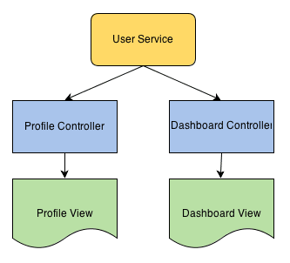
Example (Application with 2 controllers)

Slide 5
Angular JS Internal Services
By default, Angular provides many services which can be used in our application for different purposes.
$http, $window, $location, $route are some of the commonly used services
These services can be used is any of the controllers by just declaring them as dependencies

Slide 6
Example
var app = angular.module(“myApp”,[]);
app.controller('FooController', function($http){
//...
});
app.controller('BarController',function($window){
//...
});

Slide 7
Angular JS custom services
Similarly, we can define our own custom services and use them in our application whenever required.
Angular services can be declared by 2 ways –
by service method or by factory method.
Both of these ways initializes a service object which can be used from anywhere controllers, directives , filters etc.

Slide 8
Service Declaration
By service method:
var app= angular.module('myapp', []); app.service('userService', function(){ this.users = ['John', 'James', 'Jake']; });
By factor method:
app.factory('userService', function(){ var fac = {}; fac.users = ['John', 'James', 'Jake']; return fac; });

Slide 9
Service vs factory
When using a Service, its instantiated with the ‘new’ keyword. Because of this we will add properties to “this” and the service will return ‘this’.
When you pass the service into your controller, those properties on ‘this’ will now be available on that controller through your service.
app.service(“myService”, function(){
var type = ‘fruits’;
this.getType = funcyion(){
return type;
}
return this;
})

Slide 10
When you’re using a Factory you create an object, add properties to it, then return that same object.
When you pass this service into your controller, those properties on the object will now be available in that controller through your factory.
app.factory(“myFactory”,function(){
var type = ‘vegetables’;
var obj = {};
obj.getType = function(){
return type;
}
return obj;
})
-------------!!---------
app.controller(“MyCtrl”,function($scope, myFactory){
$scope.type = myFactory.getType();
})

Slide 11
Thank you!!!!

